Slide 1
EE Q1 in media

Slide 2
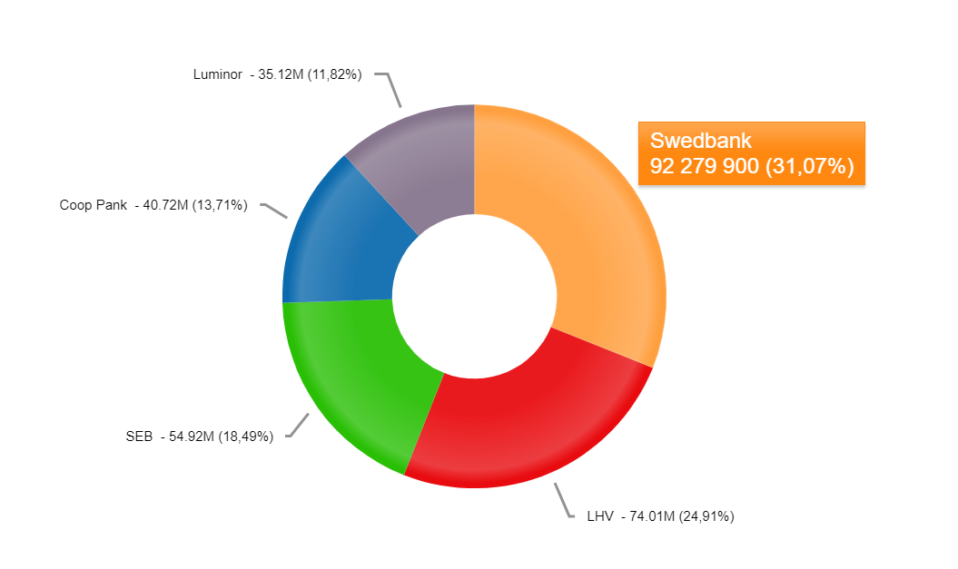
EE SOV Q1: 31,07%, in March 34,9%

Slide 3
Most popular topics
March Rapid salary growth continues The financial health of Estonians is tense Warning: new bank scam
February EURIBOR: interest rates keep growing Recruiting new employees is easier Financial markets 2023 – what to expect?
January Swedbank economic forecast Swedbank 2022: financial results Q4 Index funds

Slide 4
Good news: Term deposits
Growing since September 2022.
Have increased more than 35,4% since the beginning of the year.
Compared to year ago, the volume of term deposits of private customers has increased by 49%.
We have rised term deposits interest rates 4 times already this year.

Slide 5
Good news: Energy saving loans with zero margin

Slide 6
sTARTUp Day in March

Slide 7
People of the Year 2022 On April 1, we looked back at the year 2022 and recognized our colleagues who have been standing out.

